Slide 1
Role of Operating System, APIs & Sockets - IoT
Dr. Sanjay H A
NMIT

Slide 2
Agenda
Operating Systems
Application Programming Interface
Socket Programming
Hands-on

Slide 3


Slide 4
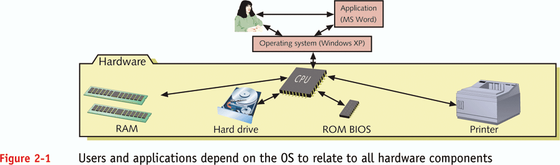
What is an operating system (OS)?

Slide 5
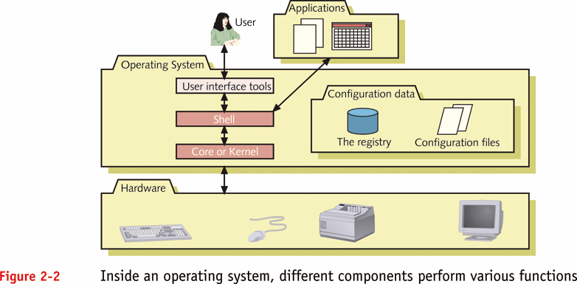
What is an operating system (OS)?

Slide 6
Definition
An operating system is an intermediary between a computer user and the hardware.
Make the hardware convenient to use.
Manages system resources.
Use the hardware in an efficient manner.

Slide 7
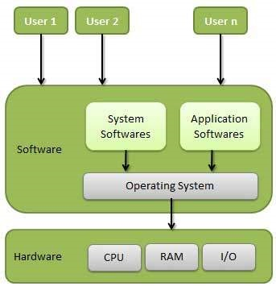

Slide 8
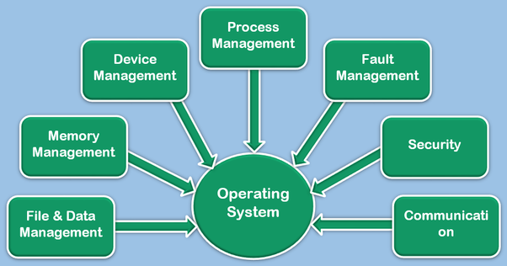

Slide 9
IoT Operating Systems
The use of operating systems for IoT hardware is often categorized into two groups:
End devices
Gateways.
End devices or nodes are often smaller in capability as compared to Gateways.
More and more processing is pushed to the network edges (to gateways and nodes),

Slide 10
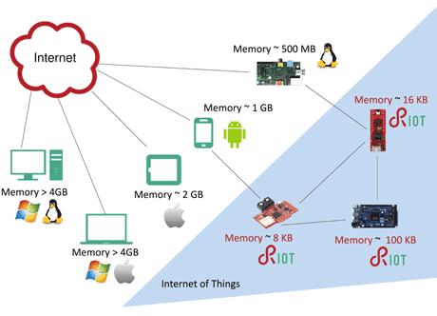

Slide 11

IoT Operating Systems

Slide 12
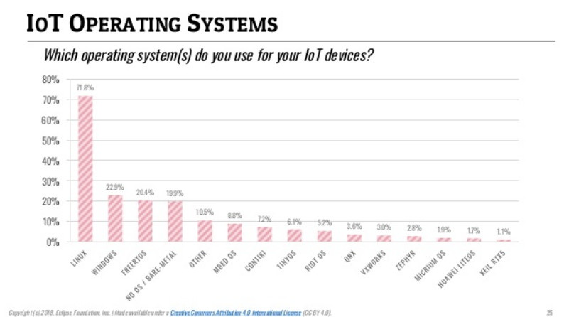

Slide 13
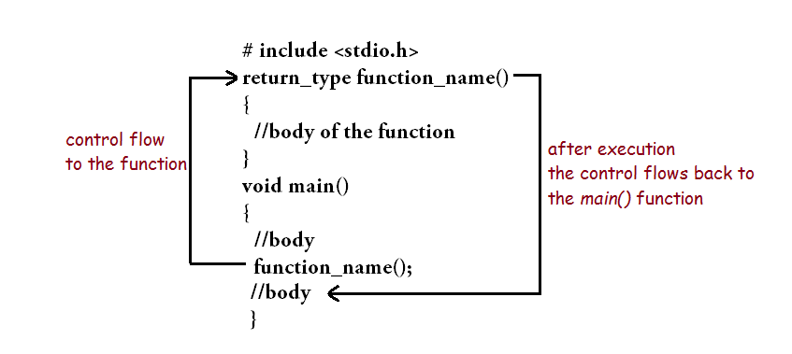
User Defined Function

Slide 14
System Calls
An OS’s system calls are called the Application Programmers Interface (API)
System calls are routines run by the OS on behalf of the user
They are run in supervisory mode
Allow user to access I/O, create processes, get system information, etc.
How many system calls an OS has varies
Unix: around a hundred
Windows: around a thousand

Slide 15
Application Programming Interface (API)
Application Programming Interface (API) contains
Software building tools
Subroutine definitions
Communication protocols that facilitate interaction between systems.
An API may be for a database system, operating system, computer hardware or a web-based system.
An Application Programming Interface makes it simpler to use certain technologies to build applications for the programmers.
API can include specifications for data structures, variables, routines, object classes, remote calls etc.

Slide 16
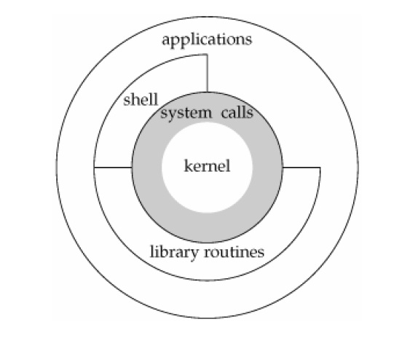

Slide 17
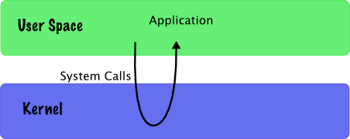

Slide 18
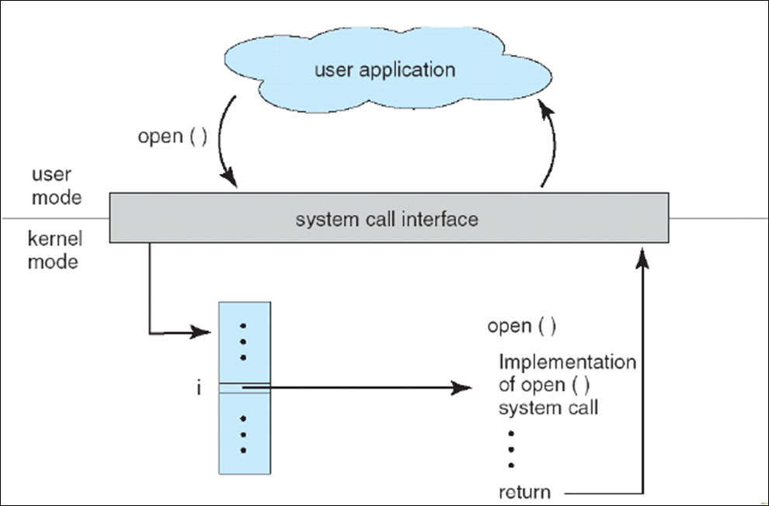

Slide 19
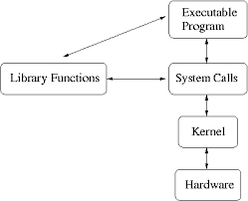

Slide 20
Library Function | System Call/API
fopen() | open()
fscanf() | read()
fprintf() | write()
fclose() | close()

Slide 21
Popular API
Google Maps API
YouTube APIs
Flickr API
Twitter APIs
Amazon Product Advertising API

Slide 22

Client- Server Application

Slide 23
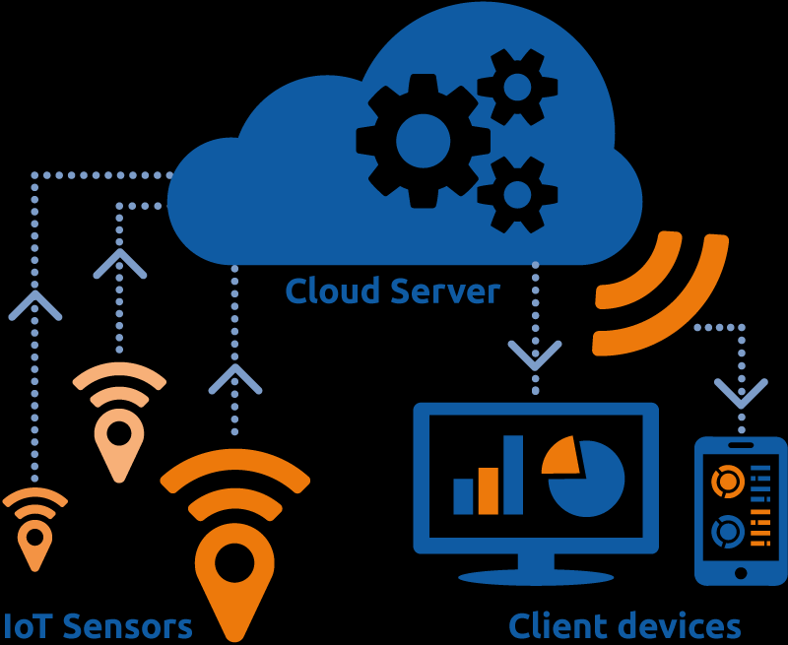
Client- Server Application

Slide 24
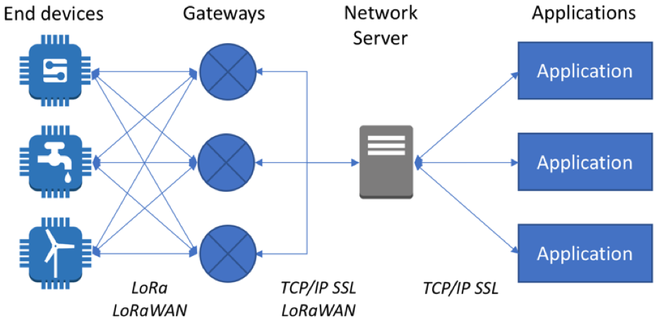
IOT Application

Slide 25
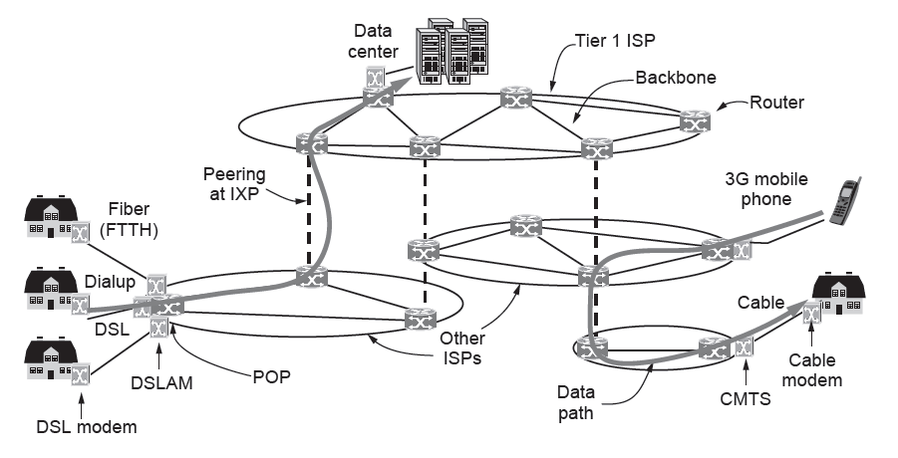
Example Networks
The Internet
Overview of the Internet architecture

Slide 26
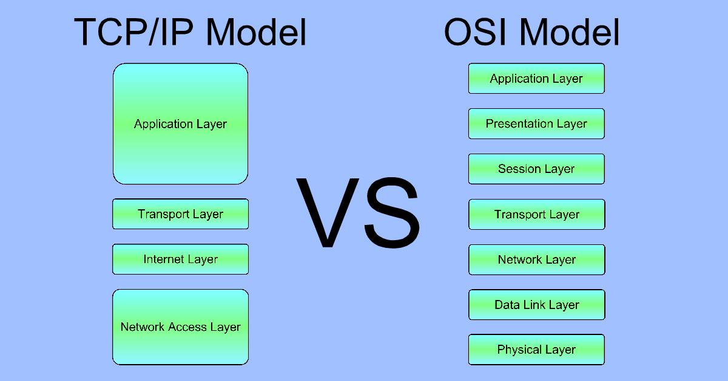

Slide 27
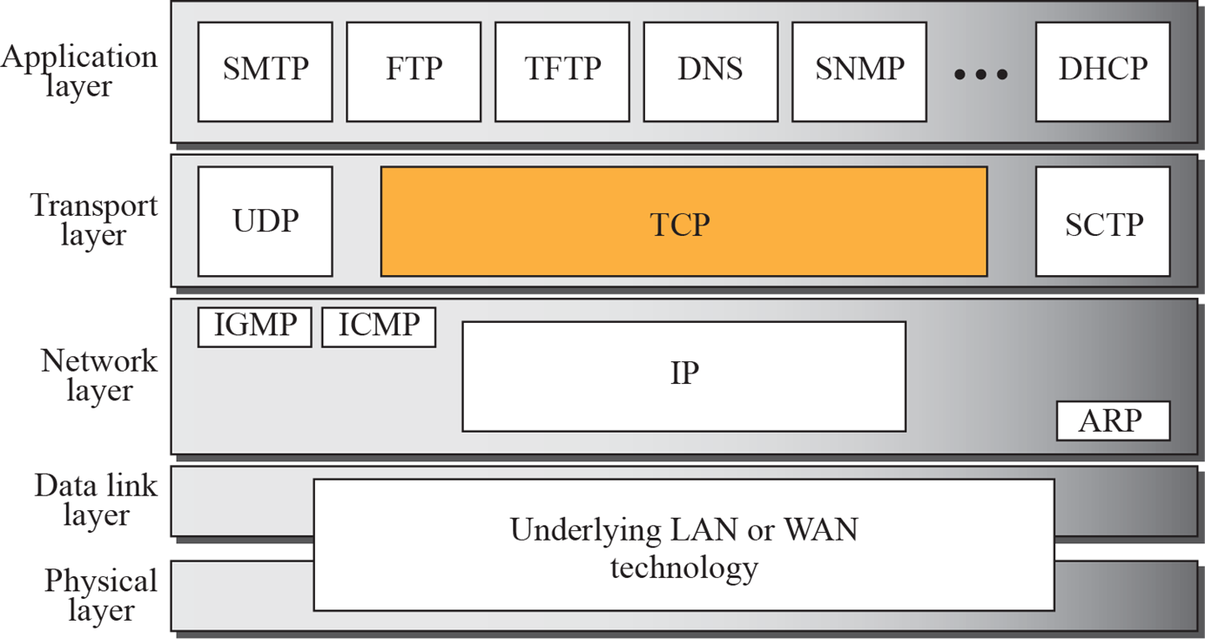
TCP/IP Model

Slide 28
UDP vs TCP
UDP
Low-level, connectionless
No reliability guarantee
TCP
Connection-oriented
Not as efficient as UDP

Slide 29
Connection-Oriented Service
A connection is established first, then used, and then released when done.
Works like a pipe:
Sender pushes data in at one end
Receiver takes them out, often in the same order, at the other end
Analogy
Telephone system

Slide 30
Figure 4.6 A connection-oriented packet switched network

Slide 31
Connectionless Service
No need to set up a connection first
Each message carrying full destination address is routed independently of others
No guarantees on the order
Analogy
Postal system

Slide 32
Figure 4.3 A connectionless packet-switched network

Slide 33
Why Socket?
How can I program a network application?
Share data
Send messages
Finish course projects...
IPC - Interprocess Communication

Slide 34
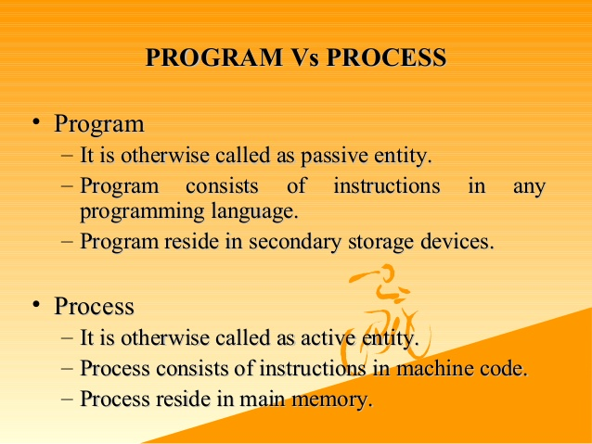

Slide 35
Identify the Destination
Addressing
IP address
hostname (resolve to IP address via DNS)
Multiplexing
port
Server socket address
208.216.181.15:80
Client socket address
128.2.194.242:3479
FTP Server
(port 21)
Client
HTTP Server
(port 80)
Connection socket pair
(128.2.194.242:3479, 208.216.181.15:80)
Client host address
128.2.194.242
Server host address
208.216.181.15

Slide 36
Sockets
How to use sockets
Setup socket
Where is the remote machine (IP address, hostname)
What service gets the data (port)
Send and Receive
Designed just like any other I/O in unix
send -- write
recv -- read
Close the socket

Slide 37
Overview
Client
Server
socket
socket
bind
open_listenfd
open_clientfd
listen
Connection
request
connect
accept
Client / Server
Session
write
read
read
write
close
EOF
read
close

Slide 38
Step 1 – Setup Socket
Both client and server need to setup the socket
int socket(int domain, int type, int protocol);
domain
AF_INET -- IPv4 (AF_INET6 for IPv6)
type
SOCK_STREAM -- TCP
SOCK_DGRAM -- UDP
protocol
0
For example,
int sockfd = socket(AF_INET, SOCK_STREAM, 0);

Slide 39
Step 2 (Server) - Binding
Only server need to bind
int bind(int sockfd, const struct sockaddr *my_addr, socklen_t addrlen);
sockfd
file descriptor socket() returned
my_addr
struct sockaddr_in for IPv4
cast (struct sockaddr_in*) to (struct sockaddr*)
struct sockaddr_in {
short sin_family; // e.g. AF_INET
unsigned short sin_port; // e.g. htons(3490)
struct in_addr sin_addr; // see struct in_addr, below
char sin_zero[8]; // zero this if you want to
};
struct in_addr {
unsigned long s_addr; // load with inet_aton()
};

Slide 40
Step 2 (Server) - Binding contd.
addrlen
size of the sockaddr_in
struct sockaddr_in saddr;
int sockfd;
unsigned short port = 80;
if((sockfd=socket(AF_INET, SOCK_STREAM, 0) < 0) { // from back a couple slides
printf(“Error creating socket\n”);
...
}
memset(&saddr, '\0', sizeof(saddr)); // zero structure out
saddr.sin_family = AF_INET; // match the socket() call
saddr.sin_addr.s_addr = htonl(INADDR_ANY); // bind to any local address
saddr.sin_port = htons(port); // specify port to listen on
if((bind(sockfd, (struct sockaddr *) &saddr, sizeof(saddr)) < 0) { // bind!
printf(“Error binding\n”);
...
}

Slide 41
Step 3 (Server) - Listen
Now we can listen
int listen(int sockfd, int backlog);
sockfd
again, file descriptor socket() returned
backlog
number of pending connections to queue
For example,
listen(sockfd, 5);

Slide 42
Step 4 (Server) - Accept
Server must explicitly accept incoming connections
int accept(int sockfd, struct sockaddr *addr, socklen_t *addrlen)
sockfd
again... file descriptor socket() returned
addr
pointer to store client address, (struct sockaddr_in *) cast to (struct sockaddr *)
addrlen
pointer to store the returned size of addr, should be sizeof(*addr)
For example
int isock=accept(sockfd, (struct sockaddr_in *) &caddr, &clen);

Slide 43
Put Server Together
struct sockaddr_in saddr, caddr;
int sockfd, clen, isock;
unsigned short port = 80;
if((sockfd=socket(AF_INET, SOCK_STREAM, 0) < 0) { // from back a couple slides
printf(“Error creating socket\n”);
... }
memset(&saddr, '\0', sizeof(saddr)); // zero structure out
saddr.sin_family = AF_INET; // match the socket() call
saddr.sin_addr.s_addr = htonl(INADDR_ANY); // bind to any local address
saddr.sin_port = htons(port); // specify port to listen on
if((bind(sockfd, (struct sockaddr *) &saddr, sizeof(saddr)) < 0) { // bind!
printf(“Error binding\n”);
... }
if(listen(sockfd, 5) < 0) { // listen for incoming connections
printf(“Error listening\n”);
... }
clen=sizeof(caddr)
if((isock=accept(sockfd, (struct sockaddr *) &caddr, &clen)) < 0) { // accept one
printf(“Error accepting\n”);
... }

Slide 44
What about client?
Client need not bind, listen, and accept
All client need to do is to connect
int connect(int sockfd, const struct sockaddr *saddr, socklen_t addrlen);
For example,
connect(sockfd, (struct sockaddr *) &saddr, sizeof(saddr));

Slide 45
Domain Name System (DNS)
What if I want to send data to “www.slashdot.org”?
DNS: Conceptually, DNS is a database collection of host entries
hostname -> IP address
struct hostent *gethostbyname(const char *name);
IP address -> hostname
struct hostent *gethostbyaddr(const char *addr, int len, int type);
struct hostent {
char *h_name; // official hostname
char **h_aliases; // vector of alternative hostnames
int h_addrtype; // address type, e.g. AF_INET
int h_length; // length of address in bytes, e.g. 4 for IPv4
char **h_addr_list; // vector of addresses
char *h_addr; // first host address, synonym for h_addr_list[0]
};

Slide 46
We Are Connected
Server accepting connections and client connecting to servers
Send and receive data
ssize_t read(int fd, void *buf, size_t len);
ssize_t write(int fd, const void *buf, size_t len);
For example,
read(sockfd, buffer, sizeof(buffer));
write(sockfd, “hey\n”, strlen(“hey\n”));

Slide 47
Close the Socket
Don’t forget to close the socket descriptor, like a file
int close(int sockfd);
Now server can loop around and accept a new connection when the old one finishes

Slide 48

THANK YOU

